Slide 1
Spatial Analysis 101 Afua Kokayi

Slide 2
Overview
A tool agnostic look at the following:
Spatial Data types
Wrangling spatial data
Analysing spatial data
Example?
Suggestions for getting started
Notes:
The idea is to give you a starting point so you know what to look for, common issues and mistakes.
I’m sure lots of us are self-taught or self improved and used a lot of google and stack exchange. But know what to search for and where to begin can be hard.
It is tool agnostic but I’ll be using a few simple examples from my work which uses python.
if you are collecting data, it is good to consider some of the points made in advance.
Often about creating a visual model of the geographic reality however the visual output and the analysis are not necessarily connected

Slide 3

About me
Completed a Masters in Geographic Data Science last year
Senior Data Analyst in OHID, on the product and data team- there is currently an EOI for my role
afua.kokayi@dhsc.gov.uk
Notes:
Advertise the EOI

Slide 4
Why analyse spatial data?
Almost everything happens somewhere
Understanding the ‘where’ can provide increased understanding
A lot of government intervention is place-based
‘Geospatial data describe both the locations and characteristics of geographical/spatial features.’ (Chang 2012, p2)
Notes:
2. John Snow and cholera- mid 1800s Soho, London
3. Important for developing policy and evaluating work that has been done

Slide 5

Notes:
GIS can mean many things but is a catch all term for the capturing, storing, analysing and displaying of geospatial data.
GIScience should study the the fundamental issues arising from geographic information

Slide 6
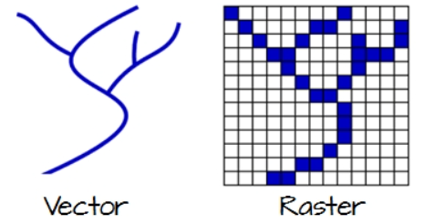
Representing Spatial Data
The world is a blank space with objects on it
The world is a continuous field with varying properties

Slide 7
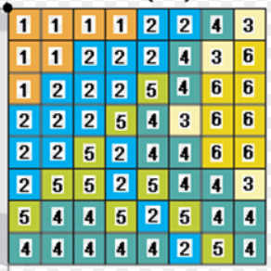
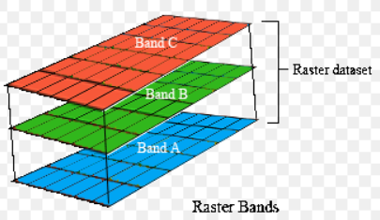
Raster data
The earth’s surface is represented as a grid of equally sized cells (pixels). An individual cell represents a portion of the earth such as a square meter or a square mile.
Each pixel has a value even if it is zero or null
Notes:
Memory intensive
Often used in earth sciences, elevation, land cover, pollution

Slide 8
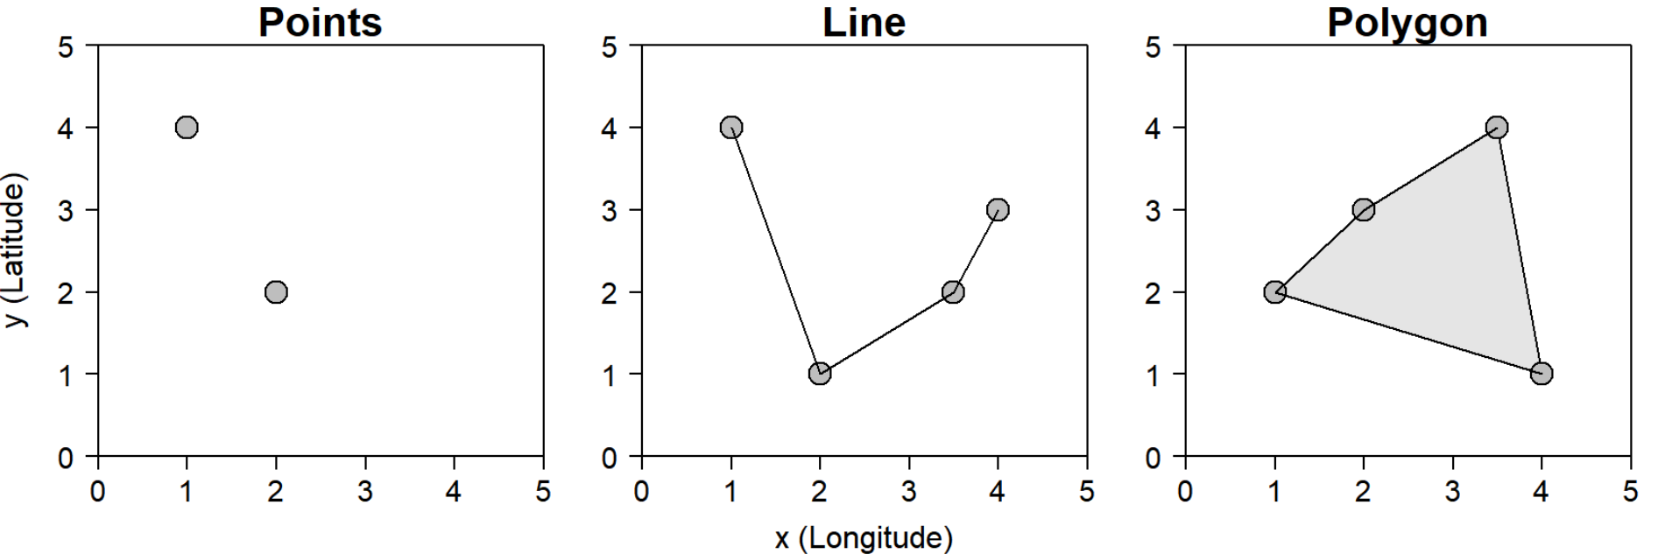
Vector data
Records the locational co-ordinates of features as point, line and area objects.
In the vector data model, every feature is assigned a unique numerical identifier, which is stored with the feature record in an attribute table
Notes:
POINT: Each individual point is defined by a single x, y coordinate.
LINE: Lines are composed of many (at least 2) vertices, or points, that are connected
AREA: A polygon consists of 3 or more vertices that are connected and “closed”.

Slide 9
Attribute table
Notes:
Emphasis that the variables and info about characteristics are important to

Slide 10
File formats
GeoJSON
GeoPackage
Shapefiles (avoid if you can)
CSV

Slide 11

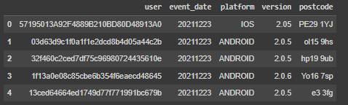
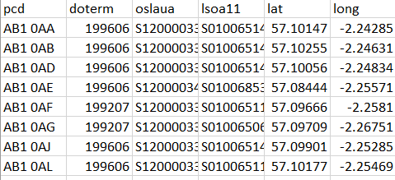
Example- where is WLP being used?
Weight Loss Plan data
ONS postcode look up
LAD boundaries with population

Slide 12
Wrangling spatial data sets
Notes:
What data cleaning or wrangling have you done on text or numeric data?

Slide 13
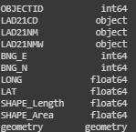
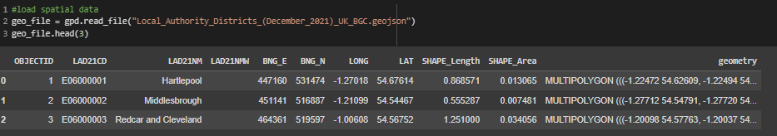
Convert text to geometry data
Notes:
You may get geographic data as text, e.g. lat/ long or northings eastings. Geometry is usually the most ideally as it allows us to access a lot of the geographic functionality of our tools

Slide 14



Change the spatial projection
Coordinate reference system refers to the way we represent the 3D Earth in 2D
The default is often WSG84 which is designed to be suitable for the globe
You can change the CRS and there are websites to check which is best for your goals
Eckert IV ETRS89 / ETRS-LAEA

Slide 15
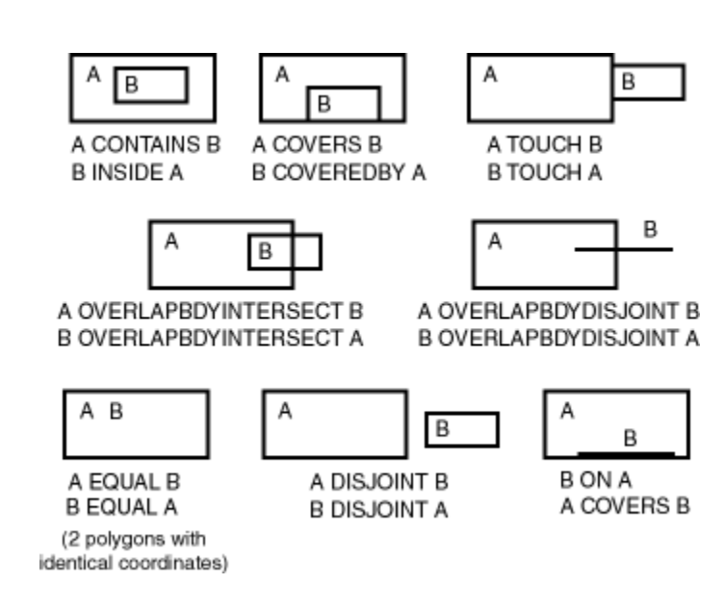
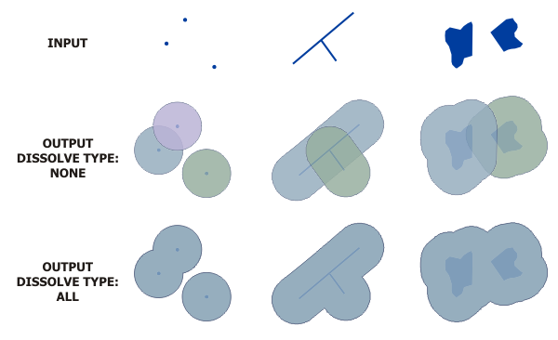
Creating new geographies
Notes:
Proximity- distance, buffer
Overlay- union, intersect, spatial join
Reclassification: merge, dissolve
Extraction: clip, select

Slide 16
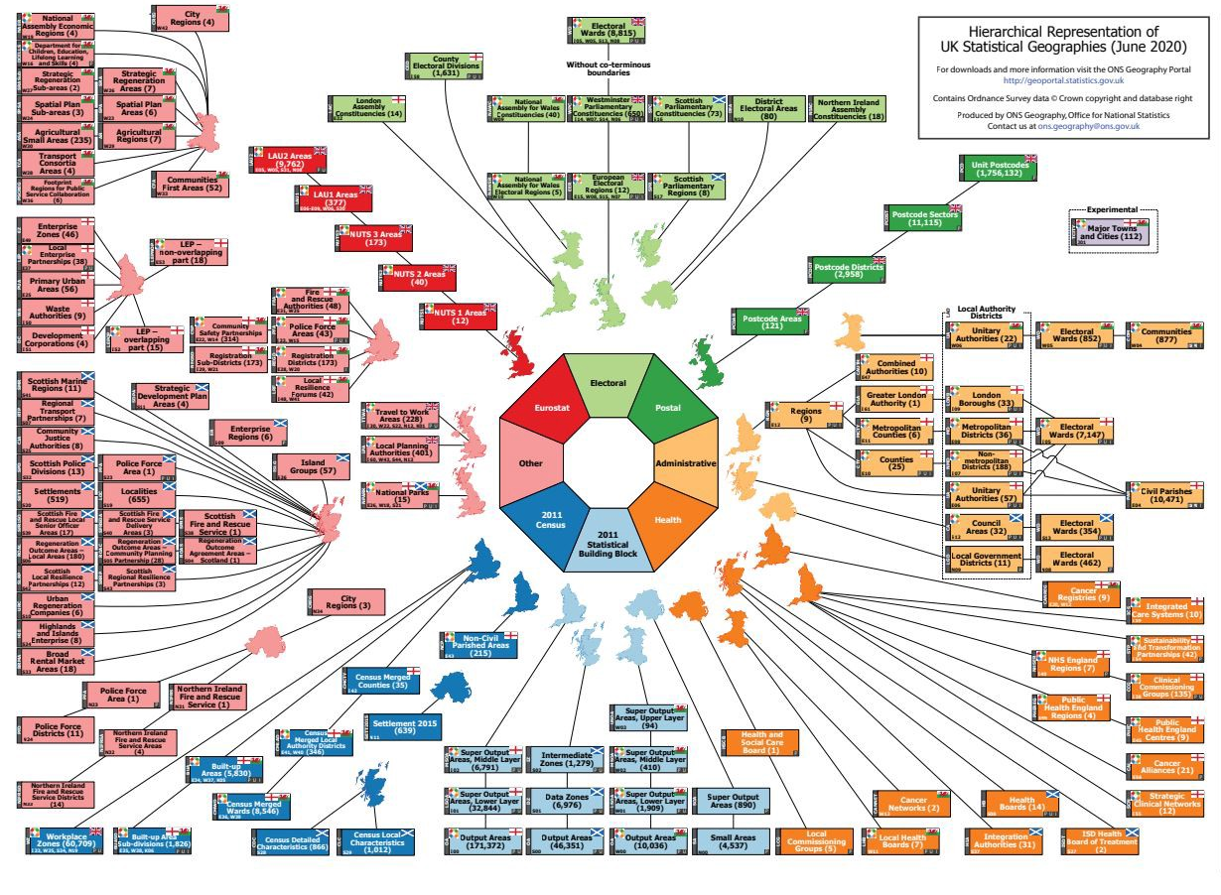
Joining data
The UK can be broken up into many different geographies
They do not always align which can make working with multiple data sets difficult.
Notes:
UK Statistical Geographies
There are also international geographies

Slide 17
Joining data
Each spatial area has a unique code which is used to join data sets.
Is usually quite simple…
Key Issue | Solution
The codes aren’t the same in all datasets | 1.Understand why this is the case- usually the boundaries have changed 2. You might be able to do some interpolation 3. The data may not be usable.
You want to link data based on different geographic breakdowns e.g. Local Authorities and Integrated Care Systems | Use a lookup file
A lookup file does not exist | Use an data apportionment technique
Notes:
The spatial units change over time- check all datasets have the same codes. Ideally you would used data from the same month and year.
Explain apportionment

Slide 18
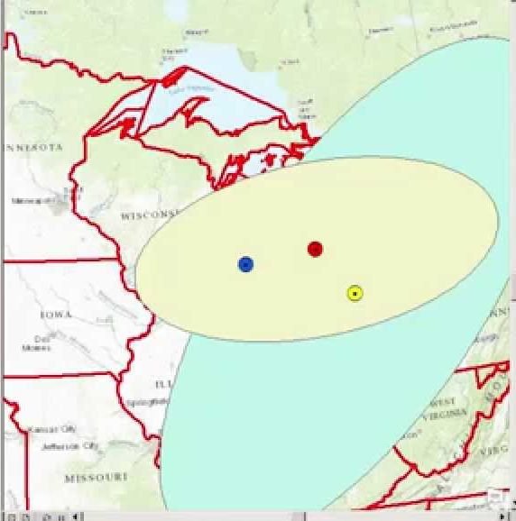
Analysing spatial data- Spatial Statistics
You can do many of the same descriptive statistics on spatial data
Mean centre
Standard Deviational Ellipses

Slide 19
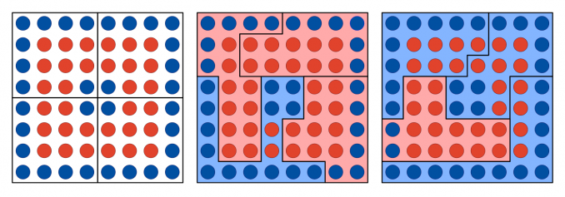
Analysing spatial data- things to consider
Modifiable Area Unit Problem (MAUP)

Slide 20
Analysing spatial data- things to consider
Spatial Autocorrelation (can be useful for spatial interpolation)
Tobler’s First Law of Geography:
‘Everything is related to everything else, but near things are more related than distant things’ (1970)
You can run Moran’s I test to check for spatial autocorrelation

Slide 21
Analysing spatial data- things to consider
Scale
Edge effects

Slide 22
Analysing spatial processes
When doing geospatial statistical analysis we are deciding to view a spatial distribution shown on a map as the outcome of some spatial process.
Thus the idea of ‘no geography’ is the starting null hypothesis for any geographical analysis.
This is usually referred to as complete spatial randomness (CSR)

Slide 23
Visualising spatial data
Use the right projection
Include a scale bar and legend
Consider your use of colour

Slide 24
Getting started
Tools
Python (Geopandas, rasterio)
R (GDAL, GEOS,PROJ)
QGIS
SpatialSQL- the examples section (5.3) of the PostGIS Documentation is a good place to start

Slide 25
Getting started
Useful data resources
Official UK boundaries: https://geoportal.statistics.gov.uk/
Official European boundaries: https://ec.europa.eu/eurostat/web/gisco/geodata/reference-data/administrative-units-statistical-units/nuts

Slide 26
Getting started
Through step-by-step guides*
Geocomputation with R: Online version of book by Dr. Robin Lovelace
Gentle introduction to GIS: Good overview of key GIS concepts (CRS, data types, spatial analysis)
Geographic Data Science with Python: Good overview of more complex analysis, still useful if you don’t use R
Earth Data Science Courses: not the right topic but does start from basics so you can pick and choose what might be useful
* N.B. I have not worked through these but they are from reputable sources in the field

Slide 27
Getting started
Miscellaneous
Get codes for different Coordinate Reference Systems (CRS): https://epsg.io/
Help choosing an appropriate CRS: https://projectionwizard.org/
Create GeoJSON objects to use when making a dataframe from scratch: https://geojson.io/
Edit map data (Thanks Phil, Moura!): https://mapshaper.org/

Slide 28
Any questions? afua.kokayi@dhsc.gov.uk

